Slide 1
Smart Garden Irrigation System for Kerala using Raspberry Pi
DES Presentation

Slide 2
INTRODUCTION
01
02
OVERVIEW
03
LITERATURE REVIEW
TABLE OF CONTENTS
04
PROBLEM DEFINITION
05
PROPOSED SOLUTION
06
INNOVATION
07
CONCLUSION & FUTURE WORK
08
REFERENCES

Slide 3
INTRODUCTION
There is an increasing need of automation in every field
Irrigation of plants on such field
Existing methods like drip irrigation, though effective to an extent are expensive and cannot be controlled
Increase in the number of homestead gardeners in Kerala post COVID as people are looking at organic food and self sufficiency
Existing Greenhouse automation systems not needed for climate of Kerala where humidity is the main factor
Most of the research focus on solutions for big farmlands and rarely for a self-sufficient home garden

Slide 4
OVERVIEW
Our case study focuses on building a cost effective automated irrigation system suitable for small to large gardens
The proposed setup uses a collection of Raspberry Pi and appropriate sensors to control water flow to plants in a cost effective manner
Garden data is sent to user by central Raspberry Pi to a Mobile App
Camera monitoring is also setup in addition
Communication between Pis and , Pi and Mobile App is done via wifi

Slide 5
LITERATURE REVIEW
Smart Home Garden Irrigation System Using Raspberry Pi
- Sayan norfilsha Ishak,Nik Noordini Nik Abd Malik, Nurul Muazzah Abdul Latiff, Ghazal N Effiyana
Proposes a cheap automated mechanism to control flow from tank to garden
However, area covered is too small and cannot be applied to anything other than balcony gardens
Zigbee based irrigation system for home gardens
- A. R. AI-Ali, Murad Qasaimeh, Mamoun AI-Mardinia, Suresh Radder and I. A. Zualkernan
focuses on communication protocols used, not so much on the type of garden
Green House Monitoring Using Raspberry Pi
-Saraswati Shelvane1, Madhuri Shedage2, Akshada Phadtare3
Proposes solutions for greenhouse, focuses a lot of temperature control
Gardens here need considerations for humidity and not so much on temperature
IoT Based Automated Irrigation System Using Raspberry Pi
proposes solution for small agriculture, not for gardens
focuses lot on water saving

Slide 6
PROBLEM DEFINITION
There has been an increase in the number of homestead farmers in Kerala looking at self-sufficiency during the pandemic [1]
Existing solutions for irrigation are costly , not fit for our climate(eg : Greenhouse automation focuses more on temperature), or are not practical for small gardens(eg: research focussed on farm automation)
In this case study we propose a model for a simple and cost effective automated irrigated solution for home gardens

Slide 7
PROPOSED SOLUTION
We assume here that a small garden might be subdivided into areas for flowers or vegetables and maybe even sub divisions for different kinds of flowers or vegetable
Our model has two main units :
Sub-unit + Takes care of controlling water flow to a particular area of the garden and sends humidity and soil moisture data to the central unit
Central Unit + Receives data from sub-units and from area wise cameras and sends it over to the mobile app
All communication is via wi-fi and the Pis talk to each other using web sockets

Slide 8
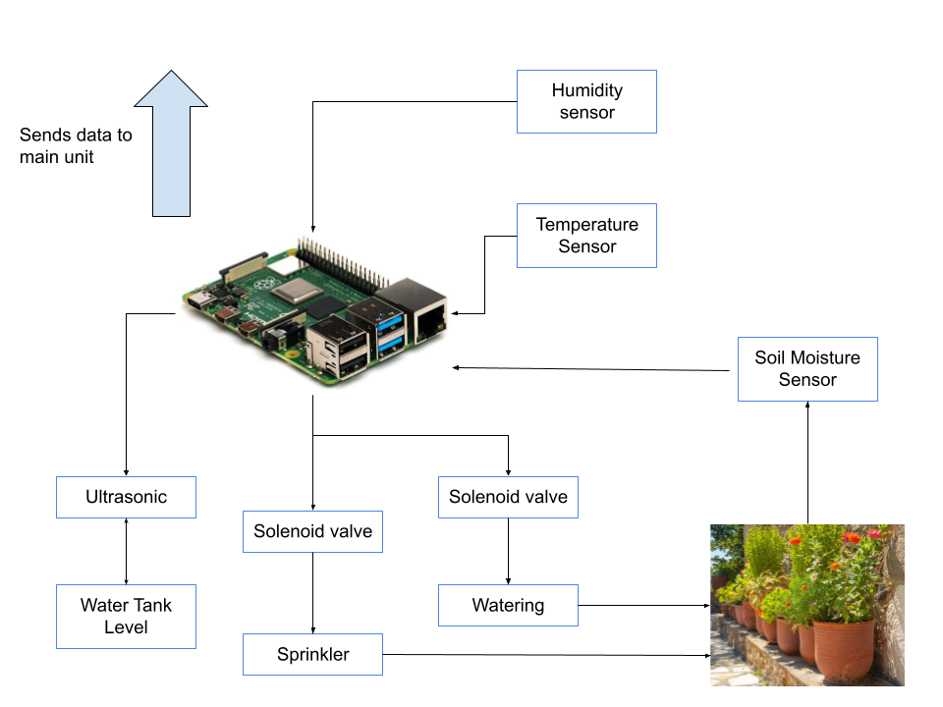
PROPOSED SOLUTION
Sub-Unit

Slide 9
PROPOSED SOLUTION
Sub-Unit
Humidity Sensor
Sends atmospherics humidity data to the Raspberry Pi . Data from the sensor is used to control the sprinkler. If the humidity goes too low sprinkler is turned on for a few minutes to bring humidity to normal levels
Sprinkler
Sprays water droplets into the area to bring humidity levels to normal. It is turned on/off by control from Raspberry Pi
Soil Moisture sensor
measures soil moisture
Raspberry Pi
Controls the the sprinkler and watering unit. Decided the amount of water to be poured from sensor data received from temperature, humidity , soil moisture sensors and tank-water level. A warning signal is sent to central unit if tank water level is too low. Also sends sensor data to the central unit periodically

Slide 10
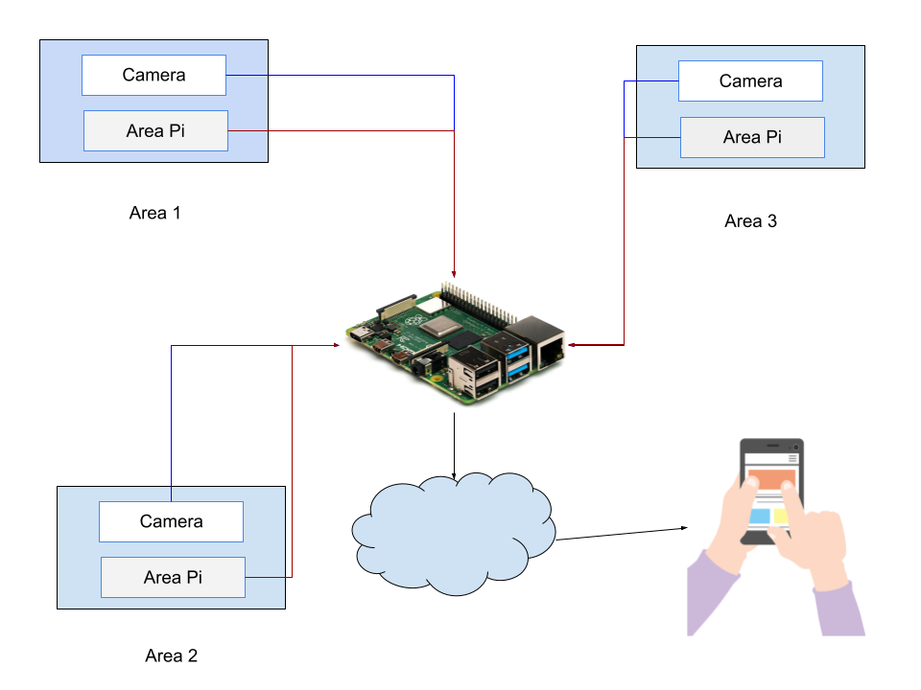
PROPOSED SOLUTION
Central Unit

Slide 11
PROPOSED SOLUTION
Central Unit
Camera
Wireless camera sends captures of garden area periodically to the central Pi. Useful in looking out for pests and birds
Area Pi
Raspberry Pi unit from each area sends data to central Pi. Also sends necessary warning signals
Central Pi
Sorts and sends data to user via Mobile app. Sends an alert in any of the Pi’s fail or in case of any other problem
Mobile App
Allows user to monitor their garden and receive real time data on demand about garden

Slide 12
PROPOSED SOLUTION
Other info
Communication
A master-slave approach is being implemented in our model [2]
Zig-Bee protocol is proposed for communication between Pis considering the factor of low cost and short range access for home gardens
Data from central Pi to mobile app is send via Wi-fi
Programming
Programming is done using Python, due to easy of use and amount of existing libraries
Temperature and humidity data of Kerala is to be collected and the control program is to be written based on the values

Slide 13
INNOVATION
Cost-effective home garden automation designed specifically for Kerala, a region with an almost constant avg temperature , high humidity interleaved by dry summer spells
Sprinkler technology combined with irrigation to preserve humid atmosphere during dry summers

Slide 14
CONCLUSION
We have thus proposed a model for a simple and cost effective solution to automated home irrigation for gardens in humid region with an almost constant avg temperature such as Kerala
Model requires a strong consistent internet connection and proposes a simple way of communication and automation for small to medium sized gardens for households looking to be self-sufficient

Slide 15
FUTURE WORK
Data needs to be collected and program needs to written and tested
Manuall setup and testing

Slide 16
REFERENCES
Smart Home Garden Irrigation System Using Raspberry Pi
https://www.researchgate.net/publication/323715665_Smart_home_garden_irrigation_system_using_Raspberry_Pi
A Survey on smart Irrigation for home Gardens
https://www.irjet.net/archives/V6/i5/IRJET-V6I5849.pdf
IOT Based Green House Monitoring System using Raspberry pi
https://nevonprojects.com/iot-based-greenhouse-monitoring-system-using-raspberry-pi/
Green House Monitoring Using Raspberry Pi and cloud
http://sersc.org/journals/index.php/IJAST/article/view/13779#:~:text=The%20greenhouse%20monitoring%20gadget%20is,saved%20on%20the%20cloud%20storage
Green House Monitoring Using Raspberry Pi
https://www.irjet.net/archives/V6/i4/IRJET-V6I41080.pdf

Slide 17
Thanks!

